Slide 1
Predicting
Air Quality Index
Shivam Chauhan, Pranay Ganapally
ALY 6020: Predictive Analytics
Northeastern University

Slide 2
What is AQI and why to predict AQI ?
The AQI is an index for reporting daily air quality. It tells you how clean or unhealthy your air is, and what associated health effects might be a concern. It’s range is from 0 to 500.
The AQI focuses on health effects you may experience within a few hours or days after breathing unhealthy air.
The higher the AQI value, the greater the level of air pollution and the greater the health concern.

Slide 3
Data
India and China are home to the 50 cities worldwide with the dirtiest air.
Seven of the world's 10 worst polluted cities are in India. New Delhi had the worst pollution levels globally in 2018.
Data was downloaded from Kaggle. Its data of AQI of New Delhi from 2017 to 2019.
9 independent variables
Target variable is PM_{2.5} AQI data

Slide 4
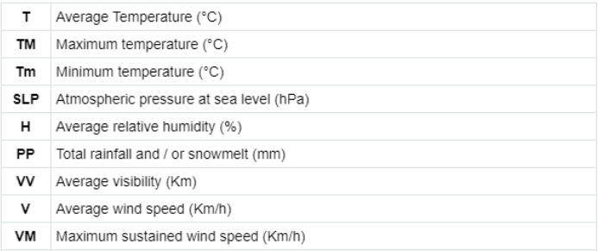
Independent Variables

Slide 5
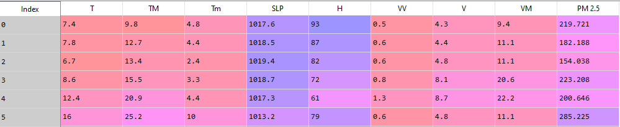
Data Cleaning
No duplicate values
Missing data was imputed with mean of that column.
Sample data:

Slide 6
EDA

Slide 7
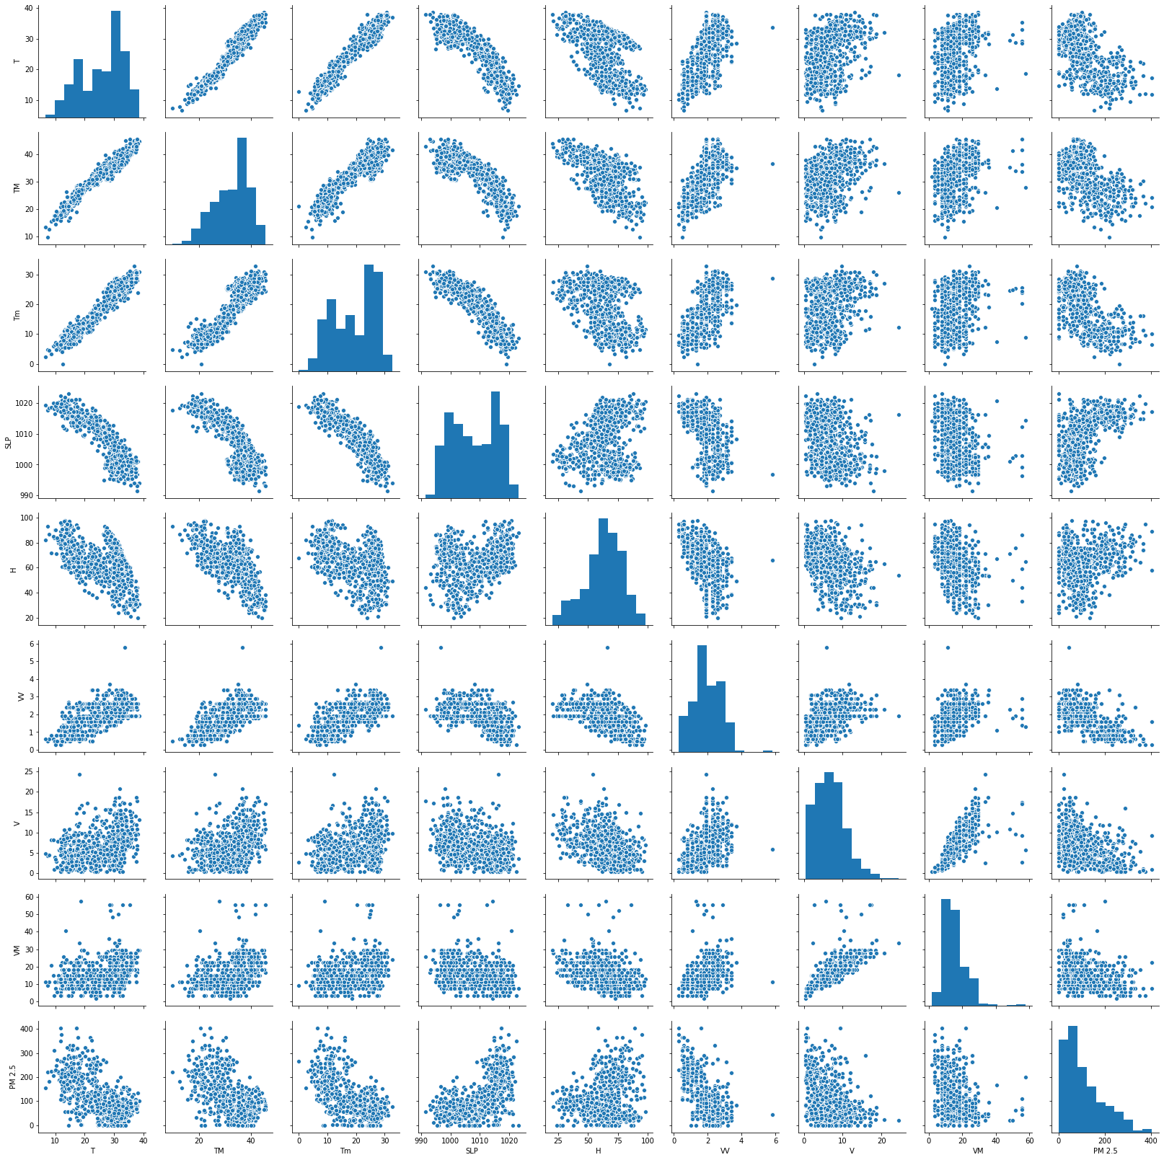
EDA

Slide 8
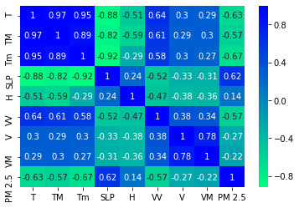
Correlation Matrix

Slide 9
Models

Slide 10
Predictive Models
Naive Bayes
Linear Regression
KNN
Decision Tree
Random Forest
XgBoost
Artificial Neural Networks

Slide 11
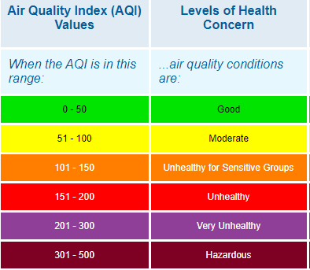

Slide 12

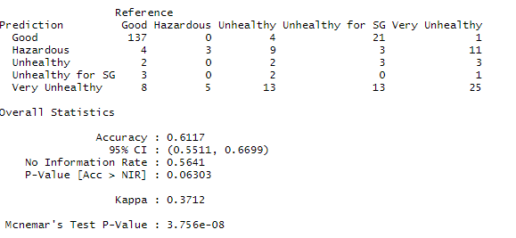
Naive Bayes

Slide 13


Model Evaluation Metrics for regressors
Mean Absolute Error (MAE) is the mean of the absolute value of the errors:
Mean Squared Error (MSE) is the mean of the squared errors:

Slide 14
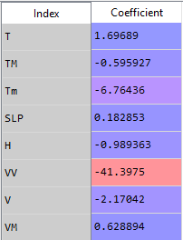
Linear Regression
Most important features are Average Temperature , Average Visibility and average wind speed.

Slide 15
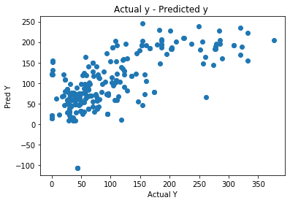

Linear Regression

Slide 16
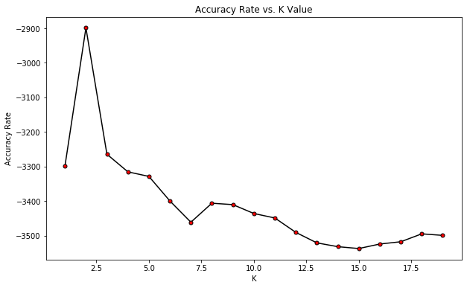
KNN
Choosing the best K value - 15

Slide 17
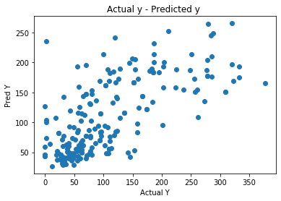

KNN

Slide 18
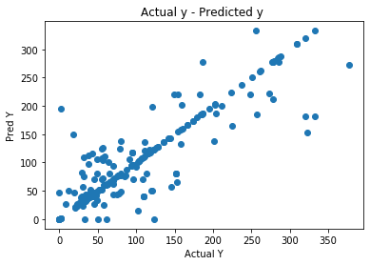

Decision Tree

Slide 19
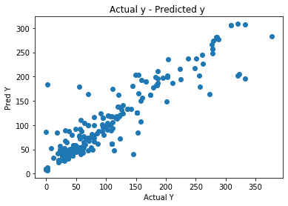

Random Forest

Slide 20
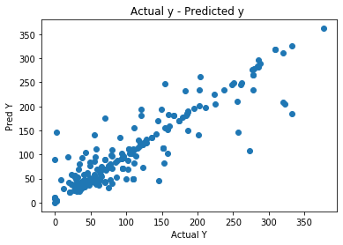

XgBoost

Slide 21
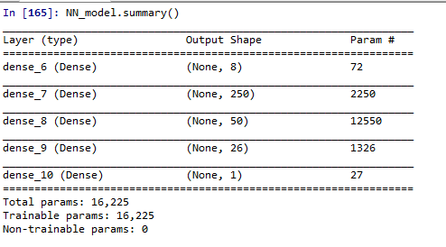
ANN

Slide 22
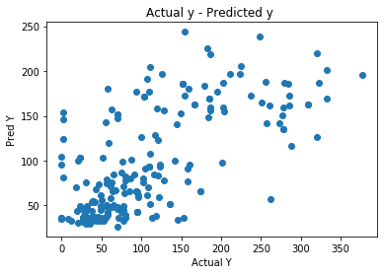

ANN

Slide 23
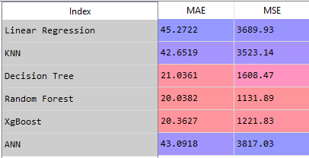
Model Comparision

Slide 24
Thank You

